Slide 1
Custom K8S/OCP automation with Operator Framework
For The PaaS Admins
By : Oren Oichman
Title: Senior Consultant - Red Hat
ooichman@redhat.com
IRC: two_oes/ooichman

Slide 2
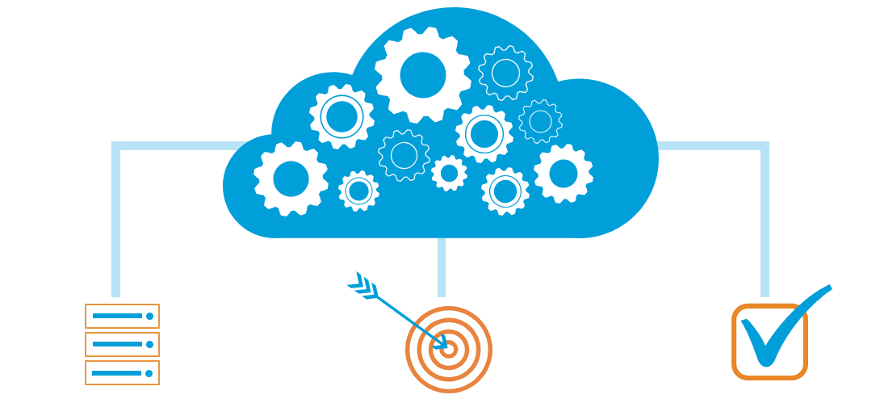
What is Automations ?
1 destination == 1000 destinations
1 task for each need (to the point)
Return a Status & Reporting
Oren Oichman - custom K8S automations with Operators

Slide 3
Known Automation IT tools
Known Automation
Bash - Shell scripting which is been used for automation
Puppet - client/Server product written in C++/ruby
Chef - Client/Server product written in C++/ruby
Ansible - Agentless automation tool written in python

Slide 4

What is Ansible
Simple, declarative-lite YAML based automation engine
Massive adoption in traditional IT management sphere
Used to deploy and manage infrastructure and applications

Slide 5
About Ansible
Ansible history
The Ansible tool was developed by Michael DeHaan, the author of the provisioning server application Cobbler and co-author of the Fedora Unified Network Controller (Func) framework for remote administration
Ansible, Inc. (originally AnsibleWorks, Inc.) was the company set up to commercially support and sponsor Ansible.^{[7][8]} Red Hat acquired Ansible in October 2015
Ansible is included as part of the Fedora distribution of Linux, owned by Red Hat, and is also available for Red Hat Enterprise Linux, CentOS, openSUSE, SUSE Linux Enterprise, Debian, Ubuntu, Scientific Linux, and Oracle Linux via Extra Packages for Enterprise Linux (EPEL), as well as for other operating systems

Slide 6


Red Hat® OpenShift® is a comprehensive enterprise-grade application platform
built for containers with Kubernetes at its core.

Slide 7
●
●
●
●

Slide 8
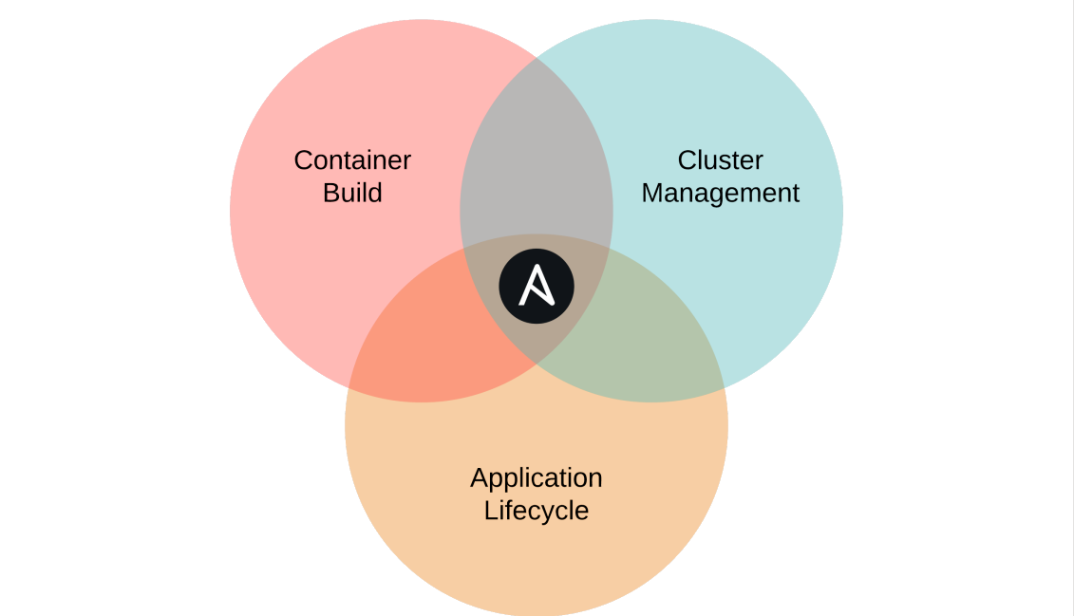

Slide 9
apiVersion: v1
- name: create foo configmap
kind: ConfigMap
k8s:
metadata:
definition:
name: foo
apiVersion: v1
namespace: default
kind: ConfigMap
data:
metadata:
color: red
name: foo
namespace: default
data:
color: “{{ color }}”

Slide 10
---
- name: create foo configmap
k8s:
definition: "{{ lookup('template', '/foo.yml') | from_yaml
}}"

Slide 11

Exercise 2
Ansible k8s Module
Oren Oichman - custom K8S automations with Operators

Slide 12

Thank you
Red Hat is the world’s leading provider of enterprise open source software solutions. Award-winning support, training, and consulting services make
Red Hat a trusted adviser to the Fortune 500.

